Slide 1


Topic: Public Key Cryptography
ITSY301- Introduction to Cryptography

Slide 2
Asymmetric encryption is a form of cryptosystem in which encryption and decryption are performed using different keys— a public key and a private key. It is also known as public-key encryption.
Asymmetric encryption transforms plaintext into ciphertext using the public key and an encryption algorithm.
Using the private key and a decryption algorithm, the plaintext is recovered from the ciphertext.
Asymmetric encryption can be used for confidentiality, authentication, or both.
The most widely used public-key cryptosystem is RSA. The difficulty of attacking RSA is based on the difficulty of finding the prime factors of a composite number.

Slide 3
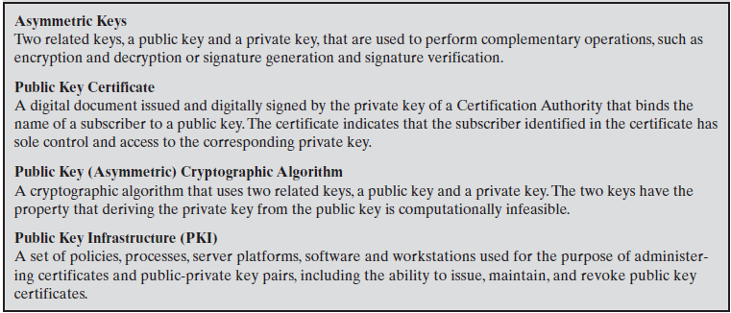
Terminology Related to Asymmetric Encryption

Slide 4
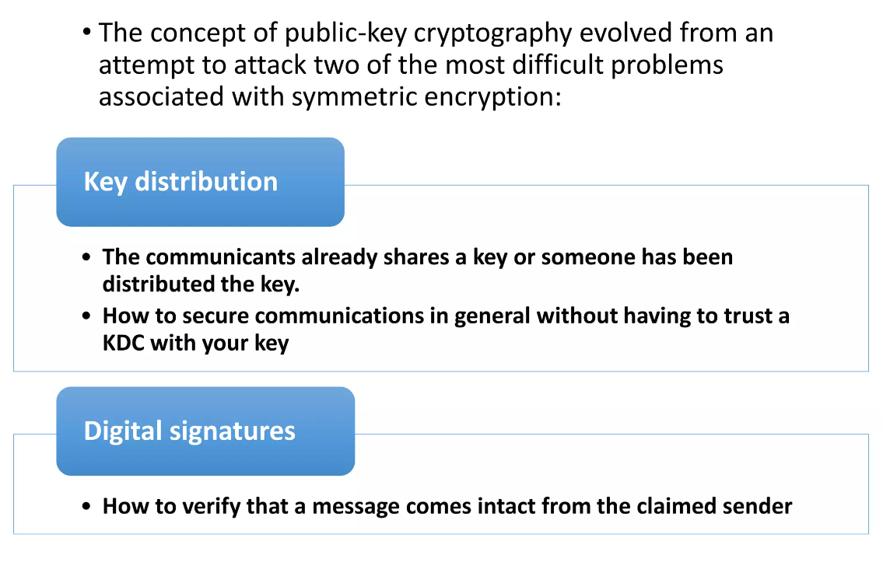
PRINCIPLES OF PUBLIC-KEY CRYPTOSYSTEMS
Notes:
The concept of public-key cryptography evolved from an attempt to attack two of the most difficult problems associated with symmetric encryption.
The first problem is that of key distribution
key distribution under symmetric encryption requires either (1) that two communicants already share a key, which somehow has been distributed to them; or (2) the use of a key distribution center.
The second problem was that of digital signatures.
If the use of cryptography was to become widespread, not just in military situations but for commercial and private purposes, then electronic messages and documents would need the equivalent of signatures used in paper documents.

Slide 5
Asymmetric algorithms rely on one key for encryption and a different but related key for decryption.
These algorithms have the following important characteristic.
It is computationally infeasible to determine the decryption key given only knowledge of the cryptographic algorithm and the encryption key.
In addition, some algorithms, such as RSA, also exhibit the following characteristic.
Either of the two related keys can be used for encryption, with the other used for decryption.

Slide 6
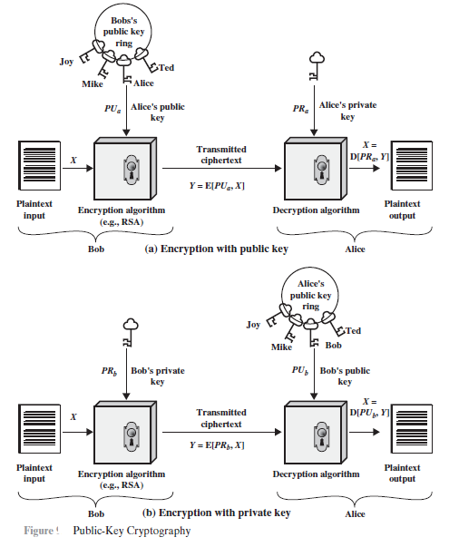
A public-key encryption scheme has six ingredients.

Slide 7
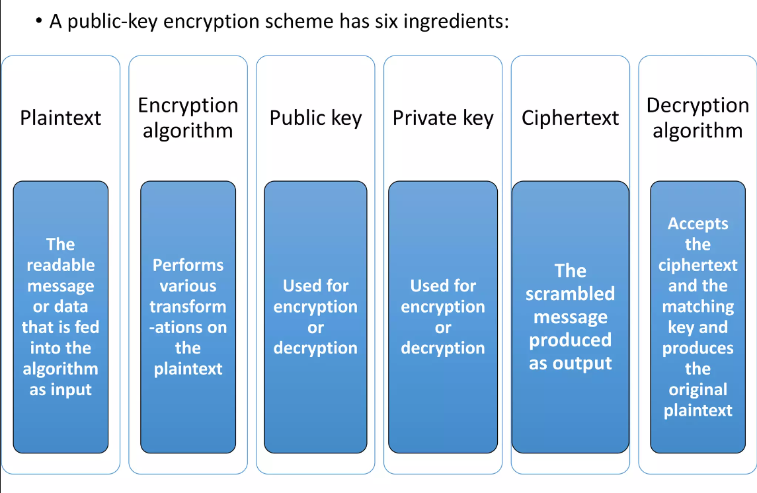

Slide 8
The essential steps are the following.
1. Each user generates a pair of keys to be used for the encryption and decryption of messages.
2. Each user places one of the two keys in a public register or other accessible file.
This is the public key. The companion key is kept private. As above Figure suggests, each user maintains a collection of public keys obtained from others.
3. If Bob wishes to send a confidential message to Alice, Bob encrypts the message using Alice’s public key.
4. When Alice receives the message, she decrypts it using her private key. No other recipient can decrypt the message because only Alice knows Alice’s private key.

Slide 9
With this approach,
all participants have access to public keys, and private keys are generated locally by each participant and therefore need never be distributed.
As long as a user’s private key remains protected and secret, incoming communication is secure.
At any time, a system can change its private key and publish the companion public key to replace its old public key.

Slide 10


Slide 11
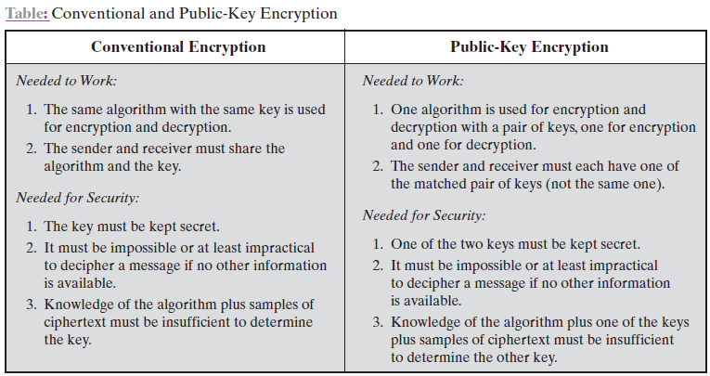
Important aspects of symmetric and public key encryption:…………
To discriminate between the two, we refer to the key used in symmetric encryption as a secret key. The two keys used for asymmetric encryption are referred to as the public key and the private key.

Slide 12
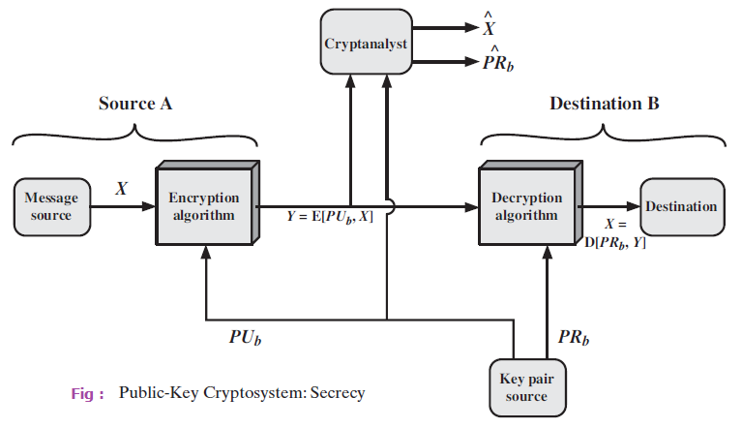
There is some source A that produces a message in plaintext, X = [X₁, X₂, . . . ,X_{M}].

Slide 13
The M elements of X are letters in some finite alphabet.
The message is intended for destination B.
B generates a related pair of keys: a public key, PU_{b}, and a private key, PR_{b}.
PR_{b} is known only to B, whereas PU_{b} is publicly available and therefore accessible by A.
With the message X and the encryption key PU_{b} as input,
A forms the ciphertext Y = [Y₁, Y₂, . . . , Y_{N}]:
Y = E(PU_{b}, X)
The intended receiver, in possession of the matching private key, is able to invert the transformation:
X = D(PR_{b}, Y)

Slide 14
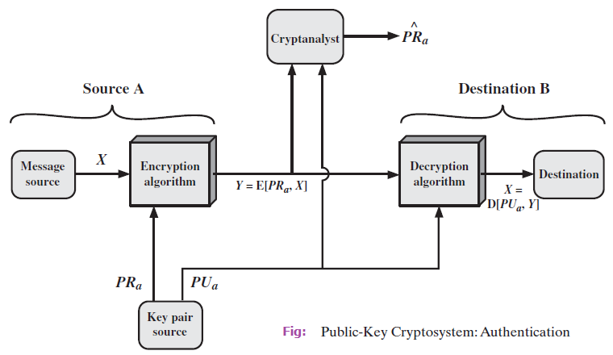
Above figure show the use of public-key encryption to provide authentication:
Y = E(PR_{a}, X)
X = D(PU_{a}, Y)

Slide 15
In this case,
A prepares a message to B and encrypts it using A’s private key before transmitting it.
B can decrypt the message using A’s public key.
Because the message was encrypted using A’s private key, only A could have prepared the message.
Therefore, the entire encrypted message serves as a digital signature.
In addition, it is impossible to alter the message without access to A’s private key, so the message is authenticated both in terms of source and in terms of data integrity.

Slide 16
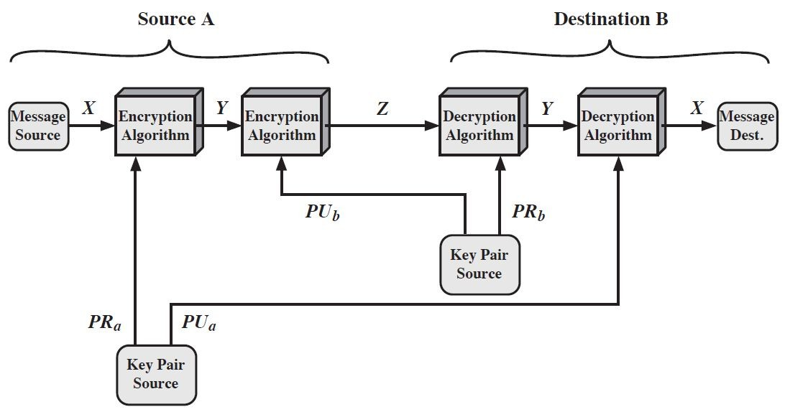
Asymmetric cryptography : confidentiality & authentication

Slide 17
Applications for Public-Key Cryptosystems
We can classify the use of public-key cryptosystems into three categories
Encryption /decryption: The sender encrypts a message with the recipient’s public key.
Digital signature: The sender “signs” a message with its private key. Signing is achieved by a cryptographic algorithm applied to the message or to a small block of data that is a function of the message.
Key exchange: Two sides cooperate to exchange a session key. Several different approaches are possible, involving the private key(s) of one or both parties.

Slide 18
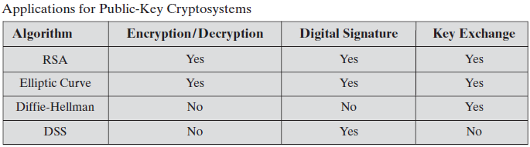

Slide 19
Public-Key Requirements
Conditions that these algorithms must fulfil:
1. It is computationally easy for a party B to generate a pair (public-key PU_{b}, private key PR_{b})
2. It is computationally easy for a sender A, knowing the public key and the message to be encrypted, to generate the corresponding ciphertext
3. It is computationally easy for the receiver B to decrypt the resulting ciphertext using the private key to recover the original message
4. It is computationally infeasible for an adversary, knowing the public key, to determine the private key.
5. It is computationally infeasible for an adversary, knowing the public key and a ciphertext, to recover the original message.
6. The two keys can be applied in either order.

Slide 20
THE RSA ALGORITHM
One of the first successful responses to the challenge was developed in 1977 by Ron Rivest, Adi Shamir, and Len Adleman at MIT and first published in 1978 [RIVE78].
The Rivest-Shamir-Adleman (RSA) scheme has since that time reigned supreme as the most widely accepted and implemented general-purpose approach to public-key encryption.

Slide 21
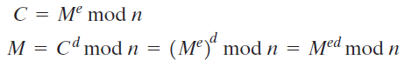
RSA makes use of an expression with exponentials. Plaintext is encrypted in blocks, with each block having a binary value less than some number n.
That is, the block size must be less than or equal to log₂(n) + 1; in practice, the block size is i bits,
where 2^{i} <n ≤ 2^{i}+1.
Encryption and decryption are of the following form, for some plaintext block M and ciphertext block C.

Slide 22
Both sender and receiver must know the value of n.
The sender knows the value of e, and only the receiver knows the value of d.
Thus, this is a public-key encryption algorithm with a public key of PU = {e, n} and a private key of PR = {d, n}.

Slide 23
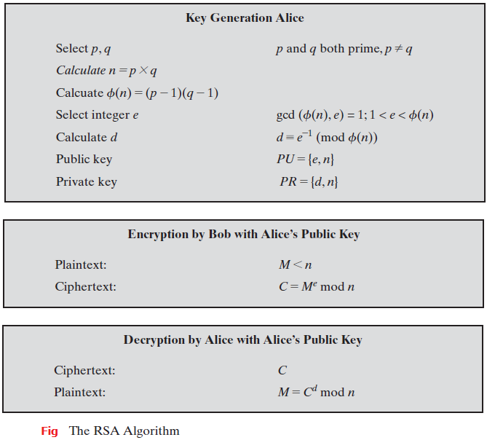

Slide 24
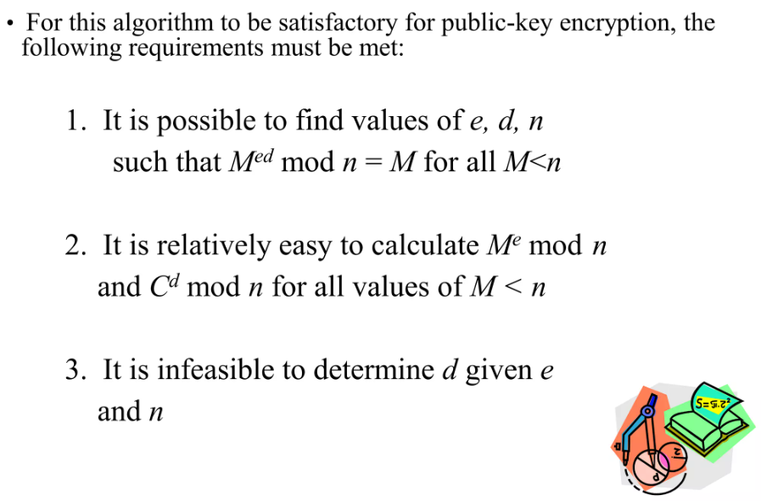
Algorithm Requirements

Slide 25
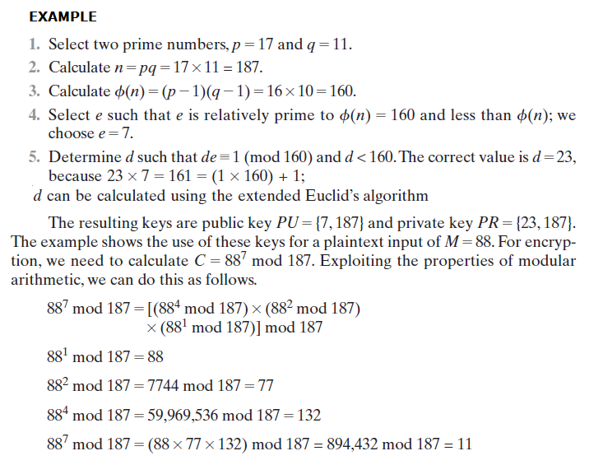

Slide 26
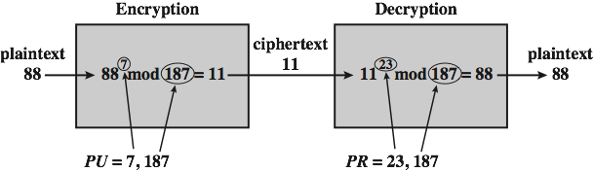

Slide 27
The Security of RSA
Five possible approaches to attacking the RSA algorithm are
Brute force: This involves trying all possible private keys.
Mathematical attacks: There are several approaches, all equivalent in effort to
factoring the product of two primes.
Timing attacks: These depend on the running time of the decryption algorithm.
Chosen ciphertext attacks: This type of attack exploits properties of the RSA algorithm.
Hardware fault-based attack: This involves including hardware faults in the processor that is generating digital signatures.

Slide 28
The defence against the brute-force approach is the same for RSA as for other cryptosystems, namely, to use a large key space. Thus, the larger the number of bits in d, the better.
However, because the calculations involved, both in key generation and in encryption/decryption, are complex, the larger the size of the key, the slower the system will run.

